Slide 1
Notes:
Cover Slide

Slide 2
PE1 System - LCR User Guide
Vincent(Thang) Nguyen l TEST IT
Notes:
Title Slide

Slide 3
Agenda
1
Login
2
LCR (Auto generate)
Notes:
Agenda/Outline Slide – Option 2

Slide 4
Login

Slide 5
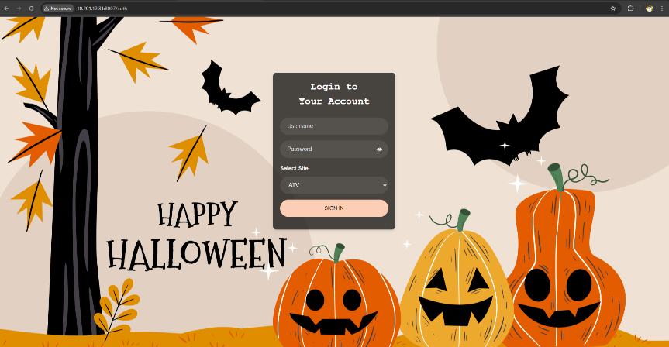
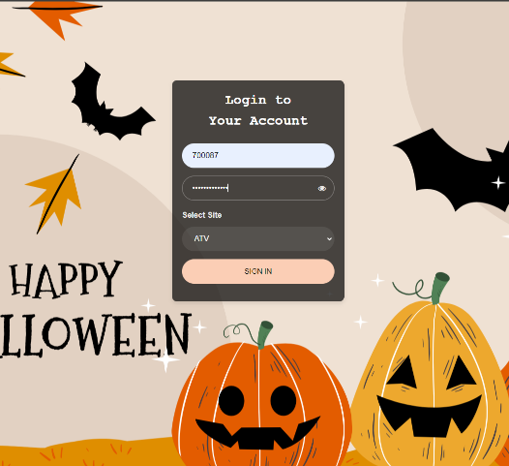
Login site
The “PE1 System” will use an AD account for the author.
The URL: http://10.201.12.31:8007
Detail:
User name same as user name login Laptop.
Ex: 700087
Password: same as Password login Laptop.
Site: Similar to your Amkor Site Ex: ATV
Login Site Empty
Login with AD account

Slide 6
LCR (Auto generate)

Slide 7
LCR (Auto generate)
Requestor
QA
START
Requesting
Create
NO
Approval
Approving
YES
Closing
END
Data flow

Slide 8
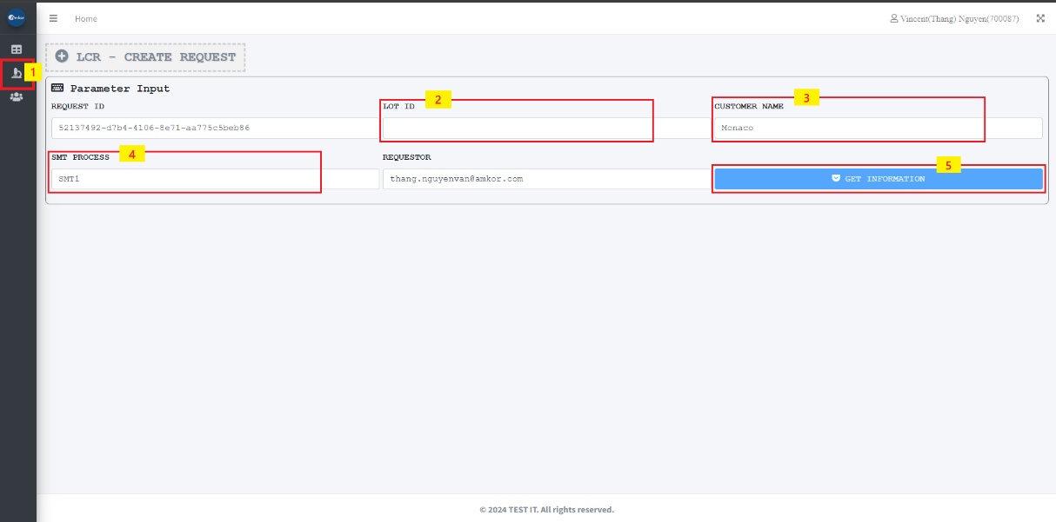
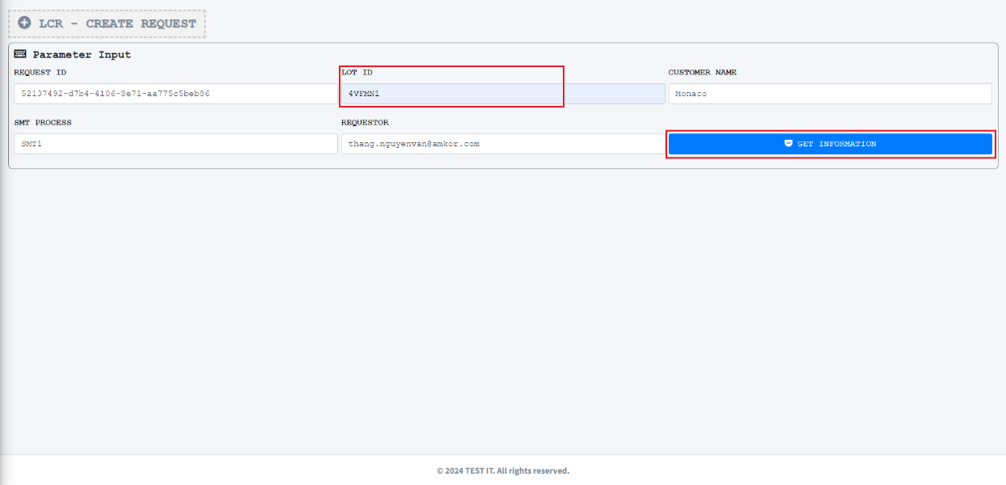
LCR (Auto generate)
Item 1: Click the “LCR” feature
Item 2: Input the “Lot ID” number
Item 3: Select the “Customer Name”
Item 4: Select the “SMT Process”
Item 5: Click the “GET INFORMATION” button. *If the “Lot ID” is empty and then the “GET INFORMATION” button is disabled
After filling in data and selecting data

Slide 9
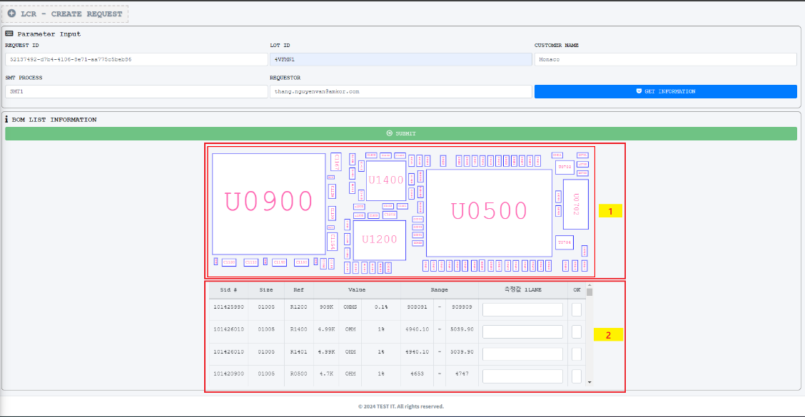
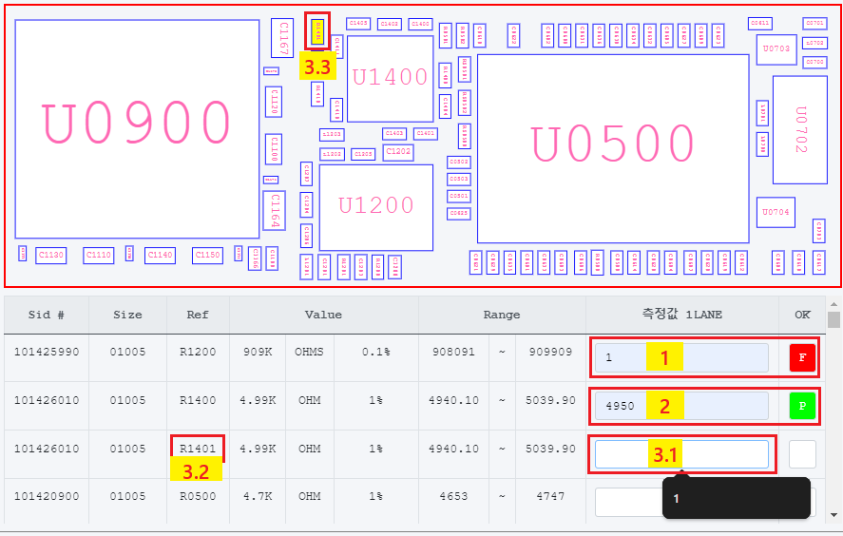
LCR (Auto generate)
After getting data from eMES and drawing the material map, auto-generate the “Measurement check sheet”.
Item 1: The material map
Item 2: The “Measurement check sheet”
1: Value out of spec, “OK” column is “F”
2: Value inside spec, “OK” column is “P”
When you click on 3.1, material 3.2 will be highlighted in the “Material Map”.

Slide 10
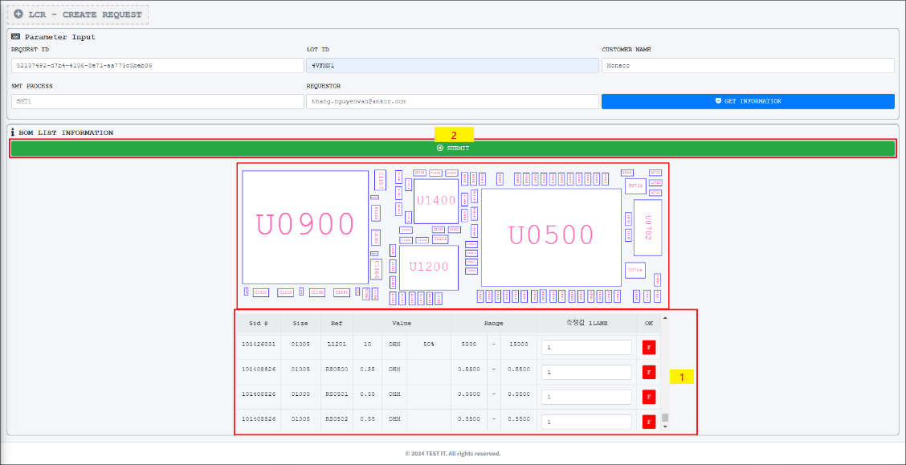
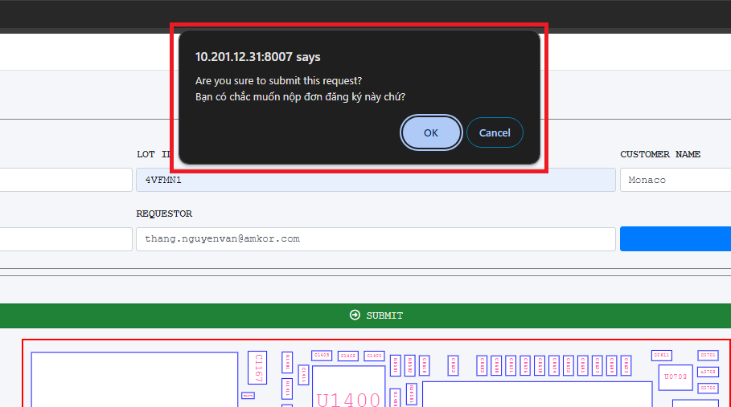
LCR (Auto generate)
After filling in all real data, the “Sumit” button will be enabled.
Click the “Submit” button will show the popup notification.
Click the “OK” button will create this request. Otherwise, do nothing

Slide 11
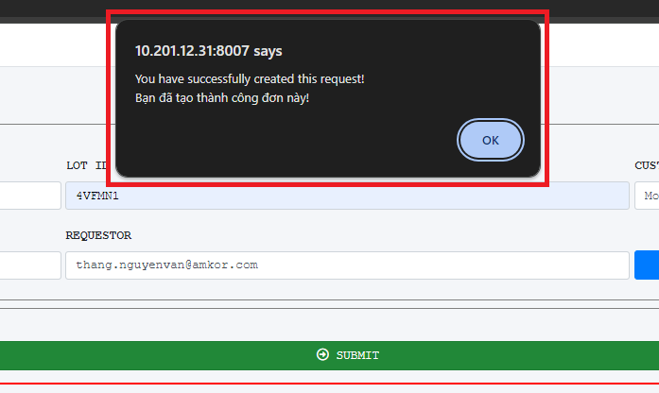
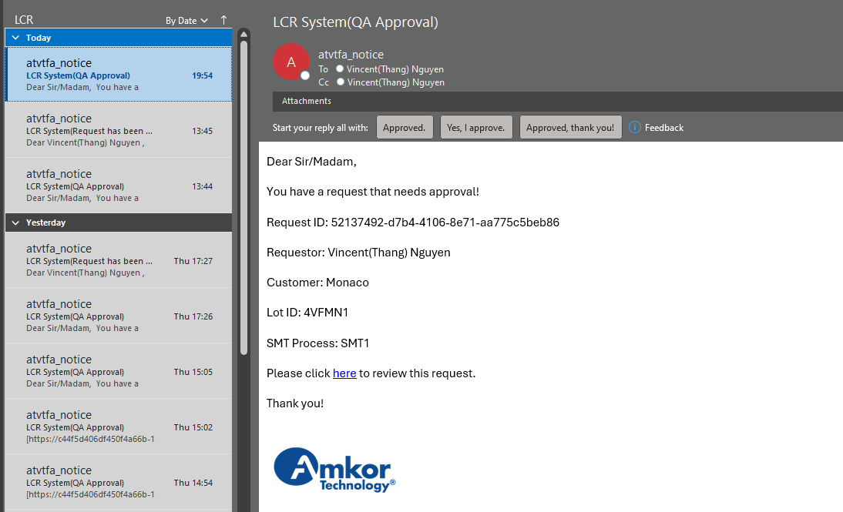
LCR (Auto generate)
Requestor clicks the “OK” button and then a notification is automatically sent to the QA member
QA member click here to see details

Slide 12
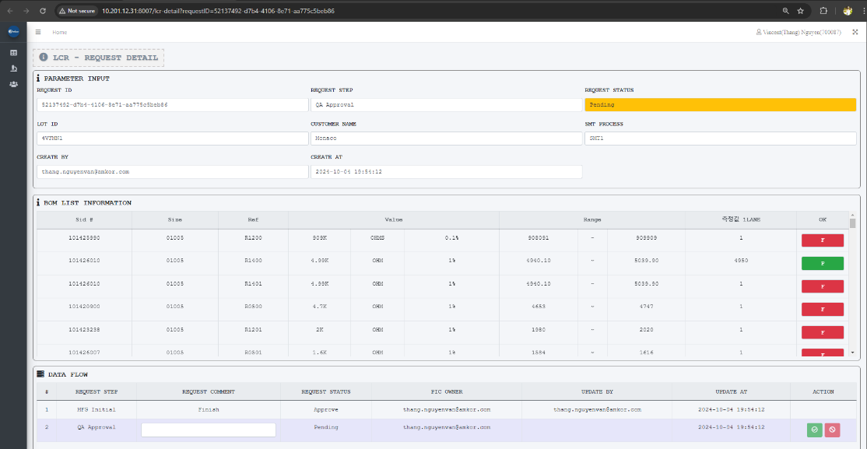
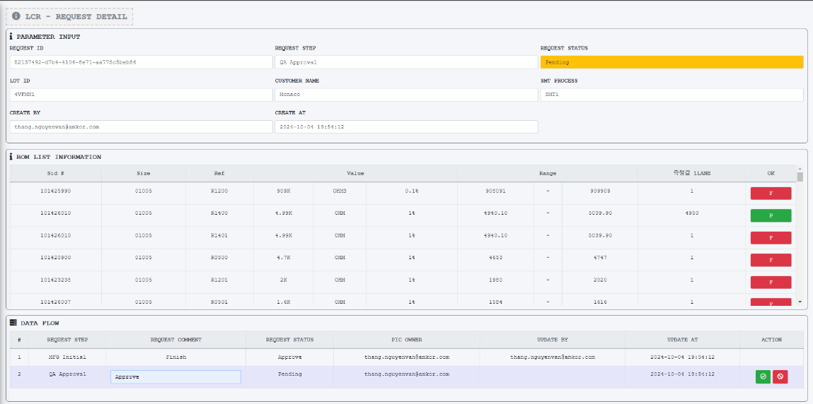
LCR (Auto generate)
After the QA member clicks here and the “LCR” detail information shows up
The QA member checks then leaves a comment and clicks Approve/Reject to move next step.

Slide 13
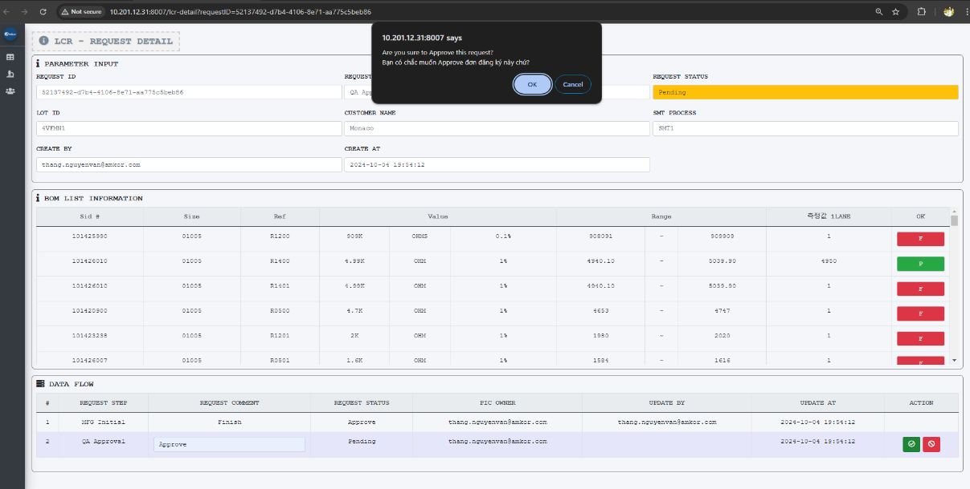
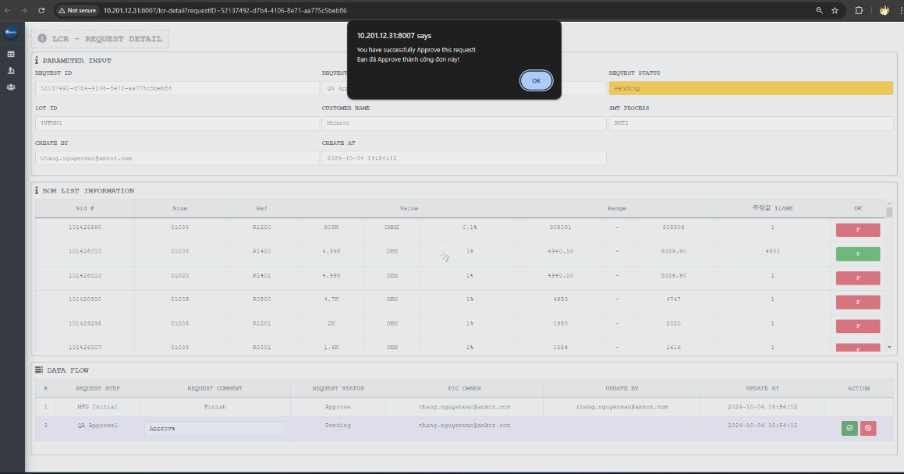
LCR (Auto generate)
The QA member clicks the “OK” button to approve the request. *Performing Reject is similar to Approve
The QA member clicks the “OK” button to finish this flow.

Slide 14
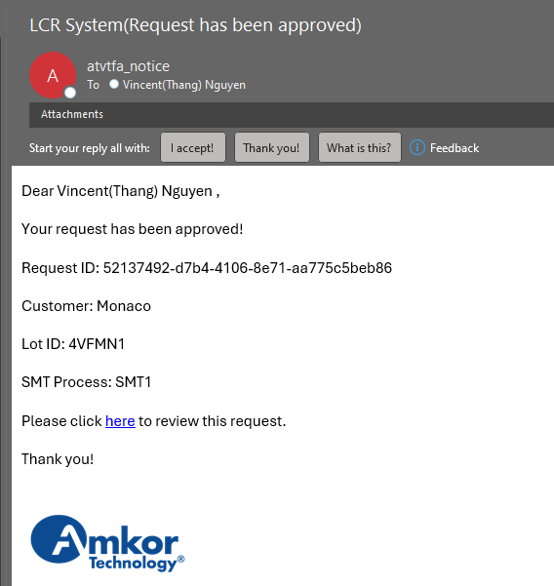
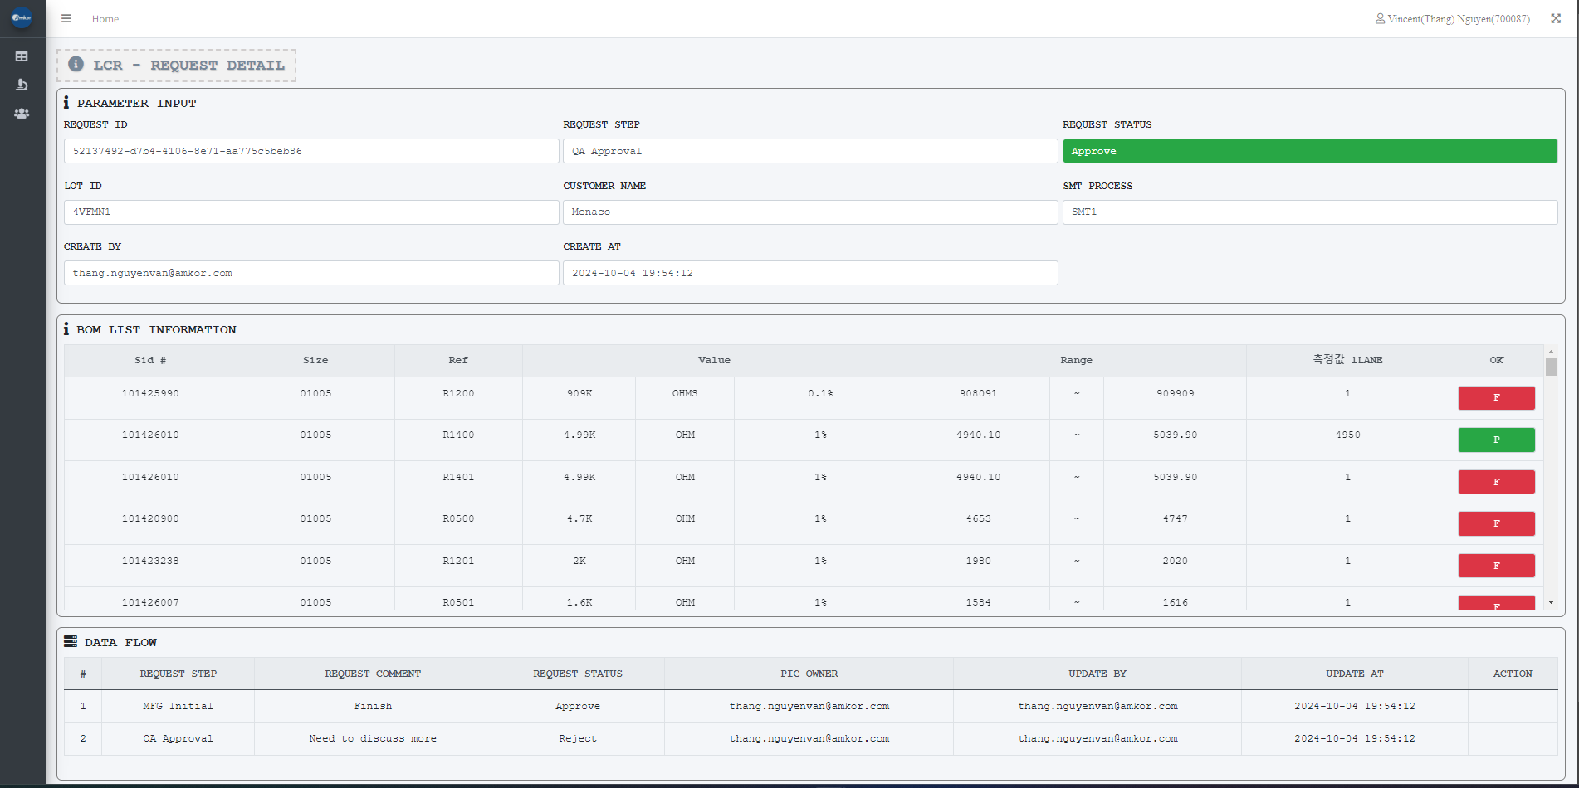
LCR (Auto generate)
The “LCR Detail” status now is Approved

